Slide 1
PythonDaySix -If statement and Brace-free coding
PoHanWu
20190203

Slide 2
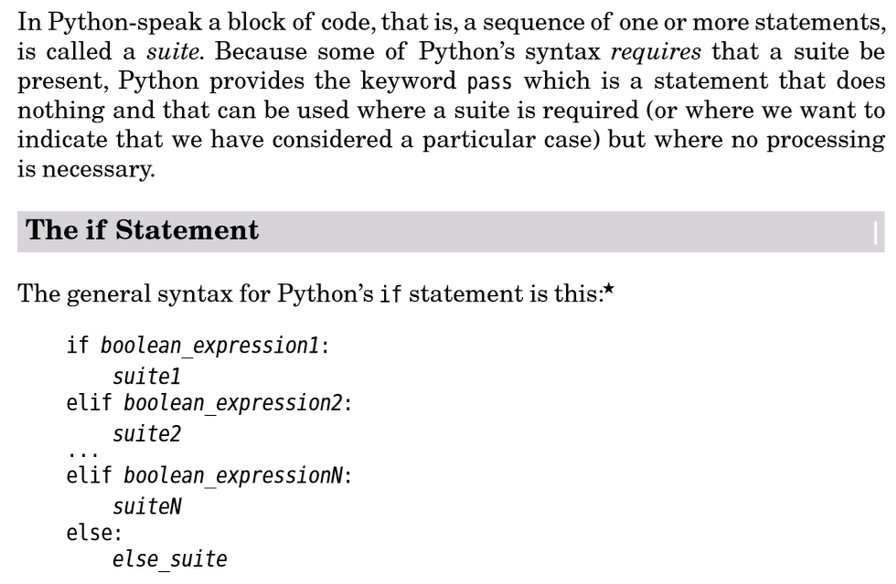

Slide 3

Python is Brace Free Code

Slide 4
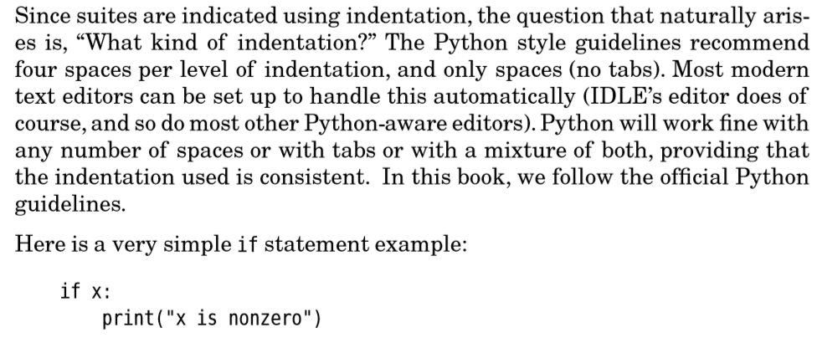
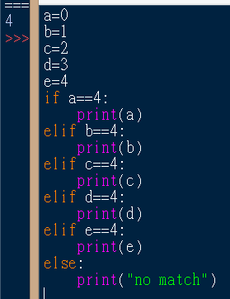

Slide 5
